Slide 1
Hyperspectral Image Segmentation
A Preliminary Study on the Oral and Dental Spectral Image Database (ODSI-DB)
Luis Carlos García Peraza Herrera
Conor Horgan
Sébastien Ourselin
Michael Ebner
Tom Vercauteren

Slide 2
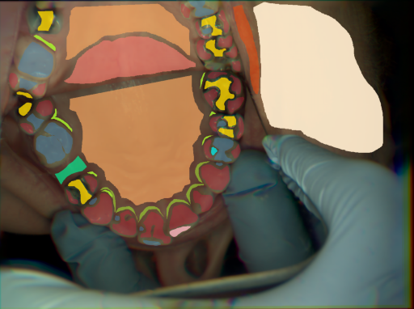
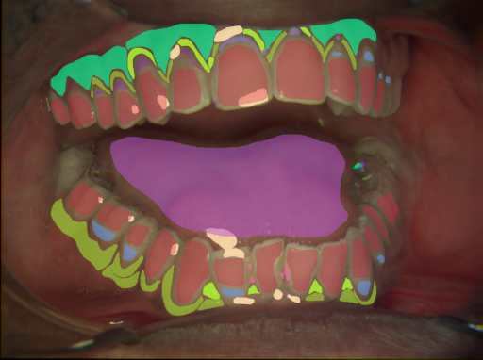

Motivation & Problem
In dentistry, RGB imaging serves a multitude of purposes, to name a few:
Patient instruction and motivation
Medico-legal reasons
Treatment planning
Liaison with dental laboratory
Assessment of baseline situation
Progress monitoring
Hyperspectral imaging (HSI) cameras capture more information than RGB
There may be perceivable differences in the reflectance spectrum of diseased tissue compared to that of healthy anatomy
A preliminary step to the development of quantitative dental and oral biomarkers is to segment the different anatomical structures accurately
Can obtain an improved segmentations with HSI?

Slide 3
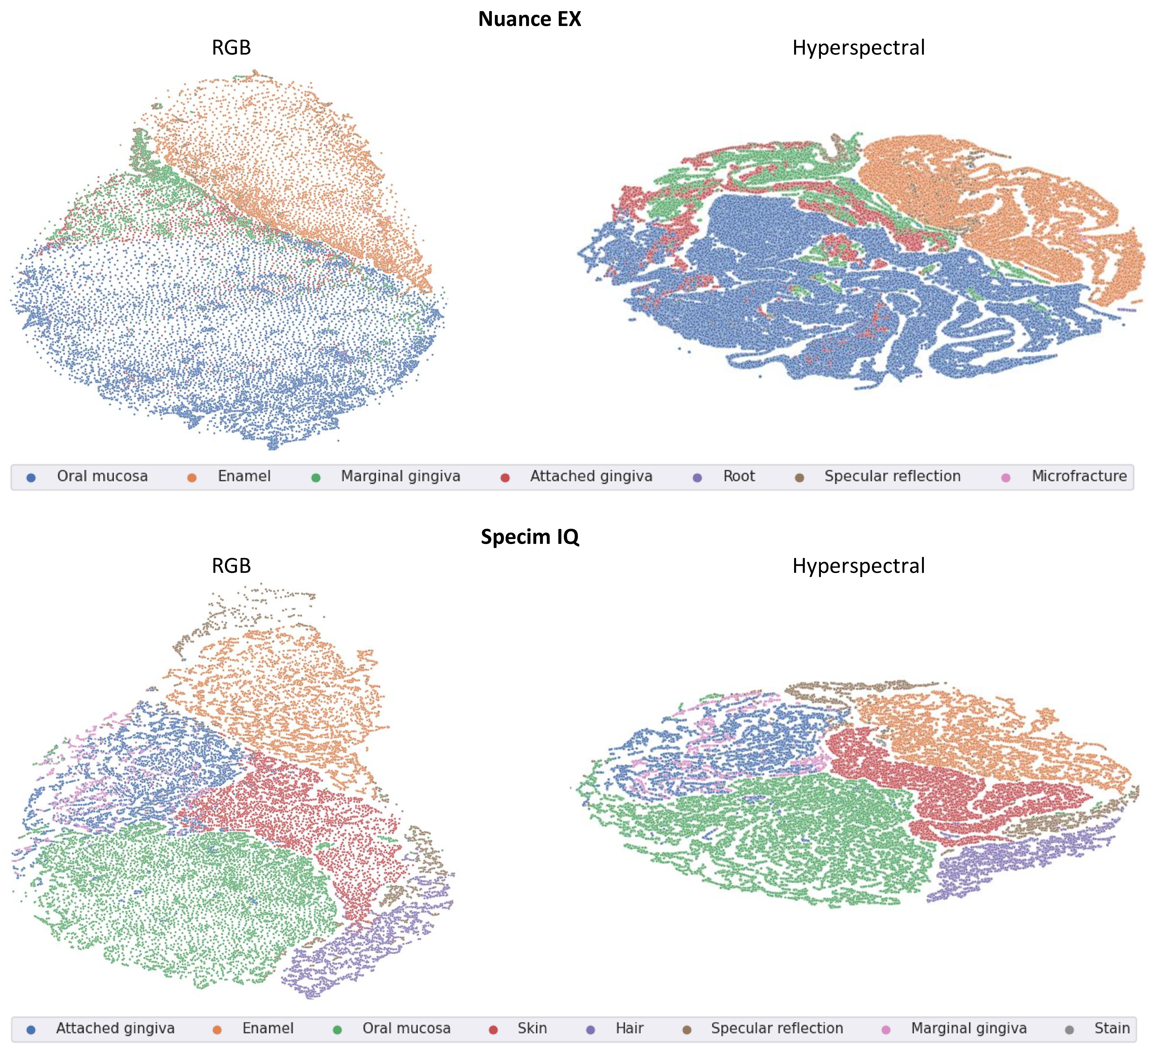
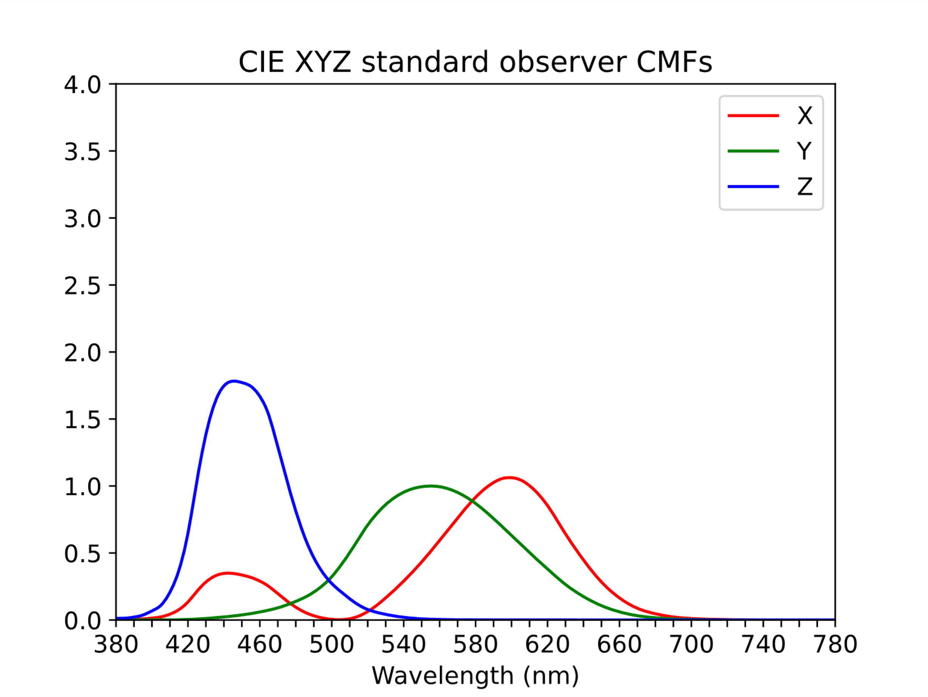
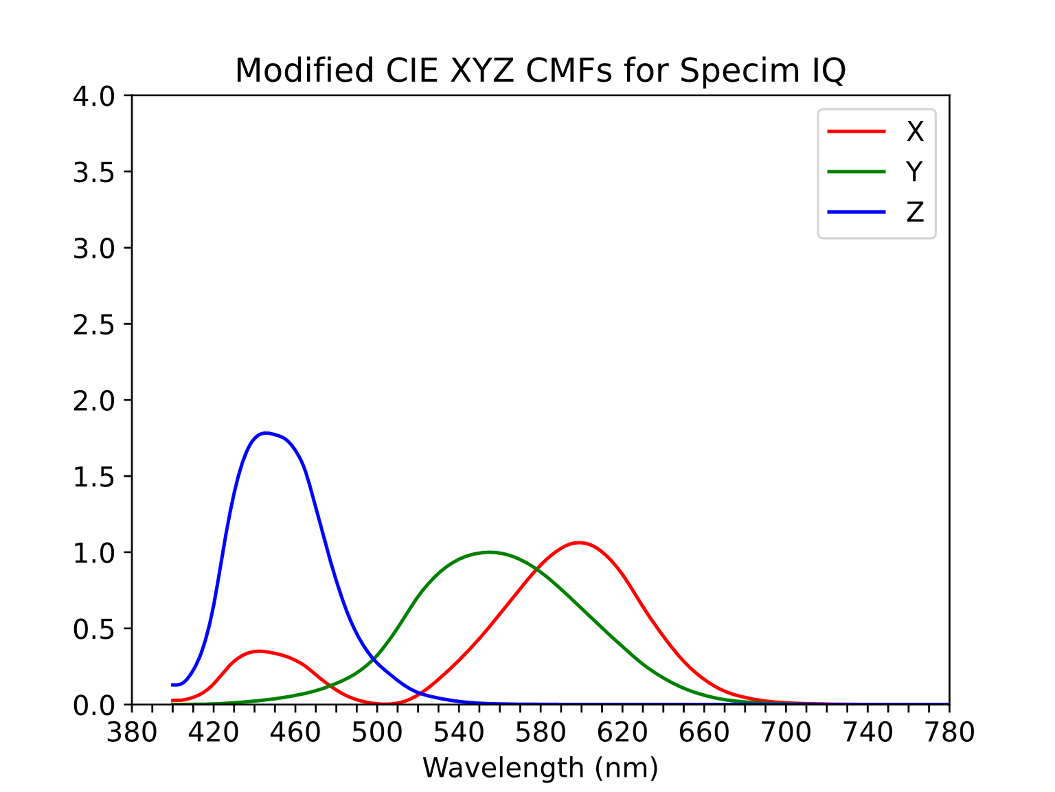
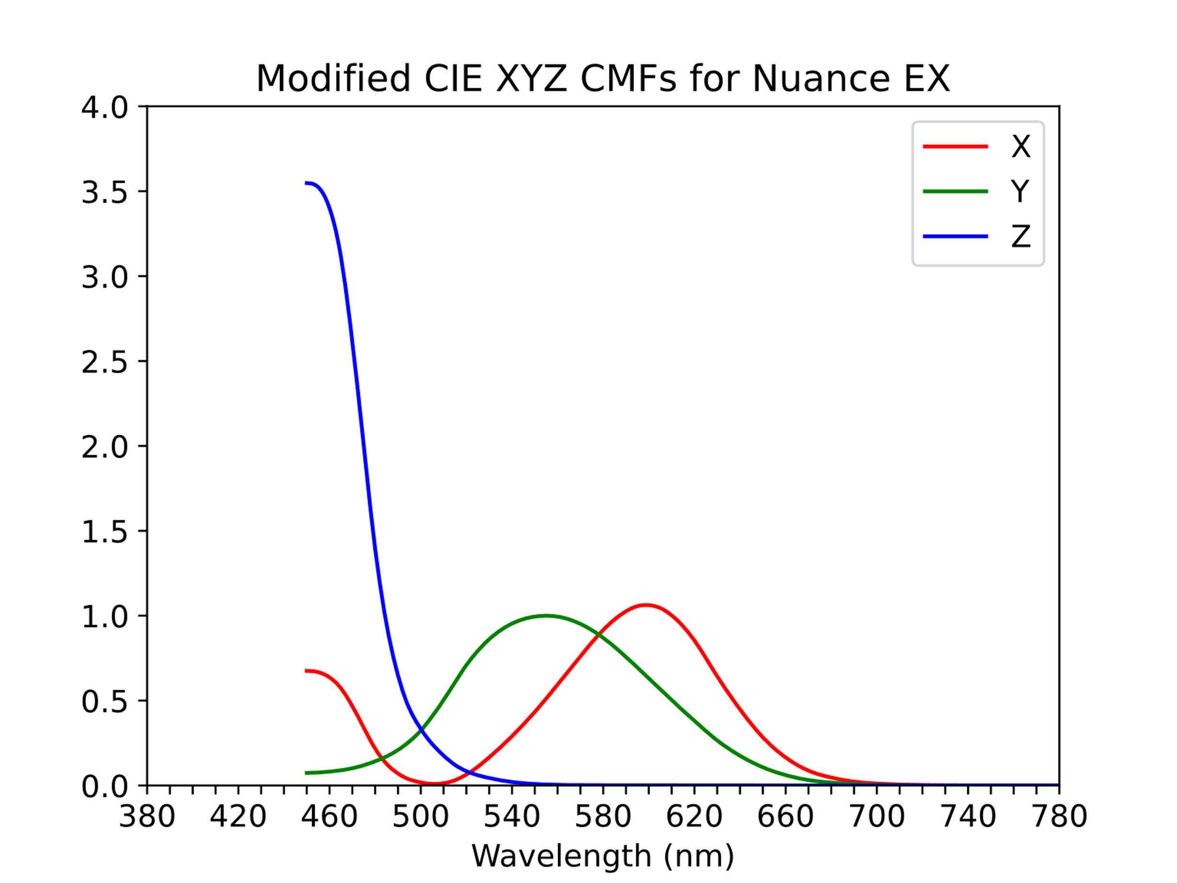
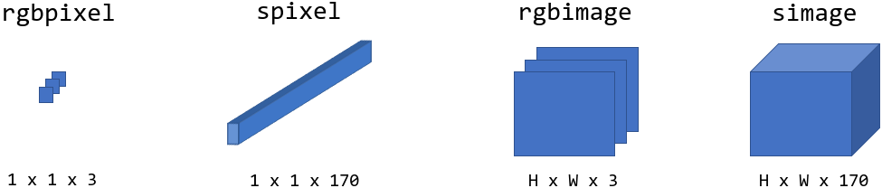
Contributions
HSI vs RGB
Conversion of HSI to RGB with support for missing side bands
Ablation study: spatial vs spectral

Slide 4
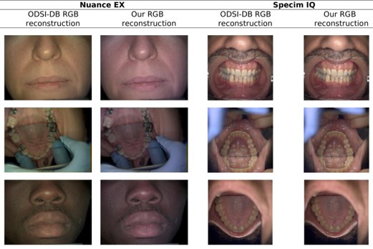
Results: HSI to RGB
Converting HSI to RGB:

Slide 5
Results: Pixel Classification
Input type | Accuracy (%)​
RGB pixels | 39.39
Hyperspectral pixels | 49.48
RGB images | 52.51
Hyperspectral images | 54.98
RGB pixels
Hyperspectral pixels
RGB images
Hyperspectral images
Class​ | Sensitivity (%)​ | Specificity (%)​ | Accuracy (%)​ | Balanced Accuracy (%)​
Attached gingiva​ | 54.89​ | 68.08​ | 67.74​ | 61.49​
Enamel​ | 56.52​ | 69.98​ | 68.64​ | 63.25​
Hair​ | 100.00​ | 68.48​ | 68.94​ | 84.24​
Hard palate​ | 44.01​ | 68.63​ | 66.40​ | 56.32​
Lip​ | 47.80​ | 68.15​ | 66.72​ | 57.98​
Oral mucosa​ | 42.95​ | 68.37​ | 66.16​ | 55.66​
Skin​ | 38.86​ | 69.33​ | 62.48​ | 54.10​
Soft palate​ | 0.00​ | 67.37​ | 67.12​ | 33.68​
Tongue​ | 2.14​ | 62.77​ | 54.61​ | 32.46​
Average​ | 43.02​ | 67.91​ | 65.42​ | 55.46​
Class​ | Sensitivity (%)​ | Specificity (%)​ | Accuracy (%)​ | Balanced Accuracy (%)​
Attached gingiva​ | 26.23​ | 99.94​ | 98.00​ | 63.09​
Enamel​ | 49.40​ | 99.04​ | 94.11​ | 74.22​
Hair​ | 84.77​ | 98.94​ | 98.73​ | 91.85​
Hard palate​ | 0.53​ | 99.64​ | 90.64​ | 50.08​
Lip​ | 33.94​ | 98.91​ | 94.34​ | 66.43​
Oral mucosa​ | 78.03​ | 92.09​ | 90.87​ | 85.06​
Skin​ | 78.19​ | 97.22​ | 92.94​ | 87.71​
Soft palate​ | 49.13​ | 99.42​ | 99.23​ | 74.27​
Tongue​ | 56.48​ | 97.20​ | 91.73​ | 76.84​
Average​ | 50.74​ | 98.04​ | 94.51​ | 74.39​
Attached gingiva​ | 54.73​ | 68.09​ | 67.74​ | 61.41​
Enamel​ | 67.49​ | 68.00​ | 67.95​ | 67.74​
Hair​ | 100.00​ | 68.48​ | 68.94​ | 84.24​
Hard palate​ | 44.01​ | 68.64​ | 66.40​ | 56.32​
Lip​ | 60.00​ | 66.77​ | 66.30​ | 63.39​
Oral mucosa​ | 42.94​ | 68.48​ | 66.26​ | 55.71​
Skin​ | 39.33​ | 69.07​ | 62.38​ | 54.20​
Soft palate​ | 0.00​ | 67.37​ | 67.12​ | 33.68​
Tongue​ | 2.14​ | 62.77​ | 54.61​ | 32.46​
Average​ | 45.63​ | 67.52​ | 65.30​ | 56.57​
Attached gingiva​ | 40.64​ | 99.48​ | 97.93​ | 70.06​
Enamel​ | 52.61​ | 98.67​ | 94.09​ | 75.64​
Hair​ | 69.61​ | 99.87​ | 99.43​ | 84.74​
Hard palate​ | 2.91​ | 99.68​ | 90.89​ | 51.29​
Lip​ | 60.49​ | 99.70​ | 96.94​ | 80.09​
Oral mucosa​ | 64.09​ | 84.95​ | 83.14​ | 74.52​
Skin​ | 86.05​ | 94.94​ | 92.94​ | 90.49​
Soft palate​ | 55.18​ | 98.82​ | 98.66​ | 77.00​
Tongue​ | 64.58​ | 98.99​ | 94.36​ | 81.79​
Average​ | 55.13​ | 97.23​ | 94.26​ | 76.18​

Slide 6

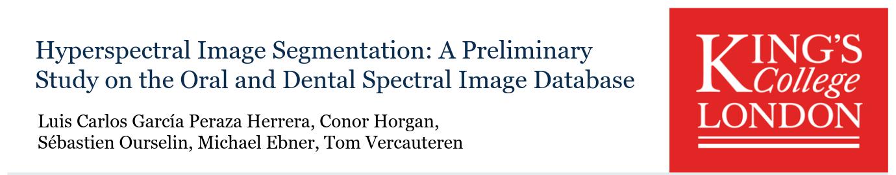
Resources
Code, data, poster & presentation:
github.com/luiscarlosgph/segodsidb
Visit Poster #22

Slide 7
Thank you
Contact details/for more information Luis Carlos García Peraza Herrera
luis_c.garcia_peraza_herrera@kcl.ac.uk
Code, data, poster & presentation
© 2022 King’s College London. All rights reserved.

